Slide 1
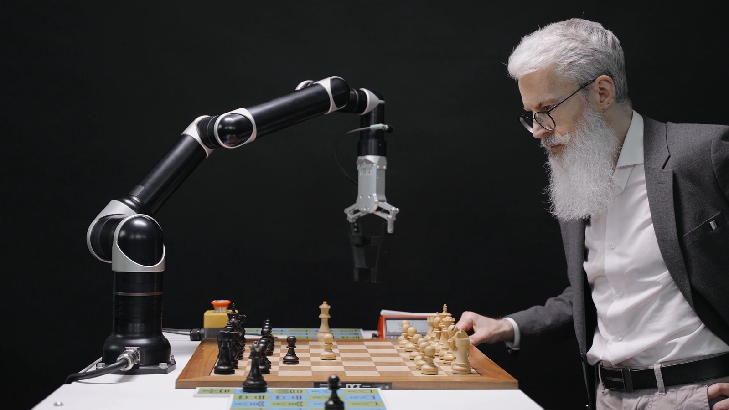
Leela Chess

Slide 2
What did I learn
HTML, CSS, and JavaScript
Object-oriented programming
Implementaion of classes and methods
recursive algorithm called minimax.

Slide 3
What is the need of chess engine?
1. Positon Analysis
- it’s always interesting to know what the chess engine thinks about the current position.
analysis of games will give you a serious advantage on the path to chess mastery

Slide 4
What is the need of chess engine?
2. Virtual chess coach
a personal trainer who is by your side every day 24/7, ready to help you at any time and playing much stronger than Magnus Carlsen.
You can train any openings, make dizzying attacks, sacrificing pieces, or, on the contrary, play solid positional chess.

Slide 5
What is the need of chess engine?
3. Testing opening books and chess engines
Bots are used by computer chess entusiasts to test engines and opening books

Slide 6
Lets see implementation

Slide 7
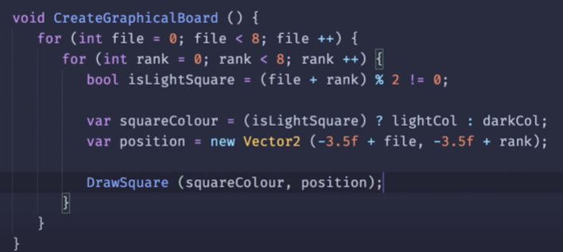
Creating Chess Board
so we’ll need two loops for the x and y axes, or files and ranks
We can tell if a square should be coloured light or dark, we can just check whether or not the file + the rank is divisible by two

Slide 8
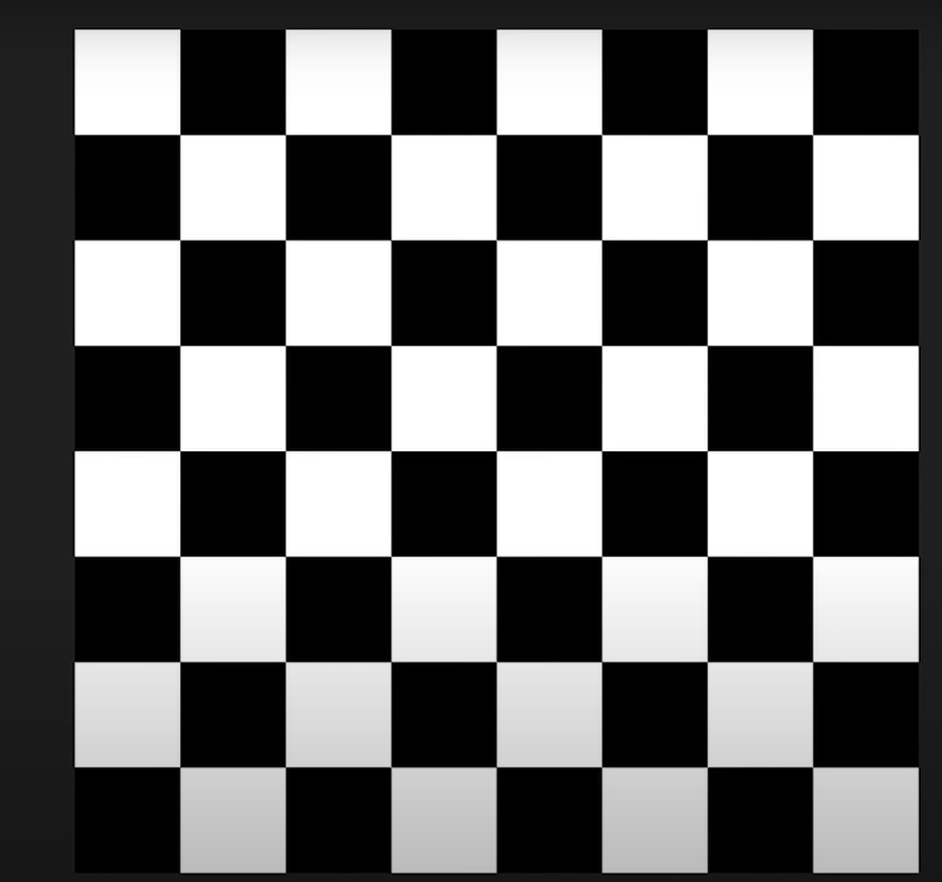
Result

Slide 9
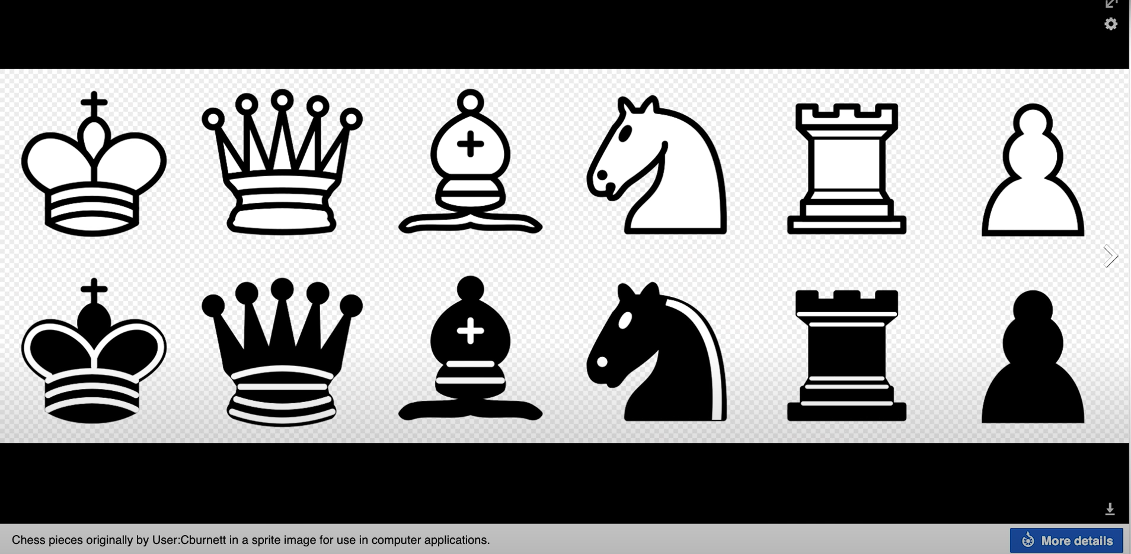
Creating Pieces
I found this nice design on Google

Slide 10
Represent pieces in code
I’ll assign each type of piece a number, along with a number for white and black

Slide 11
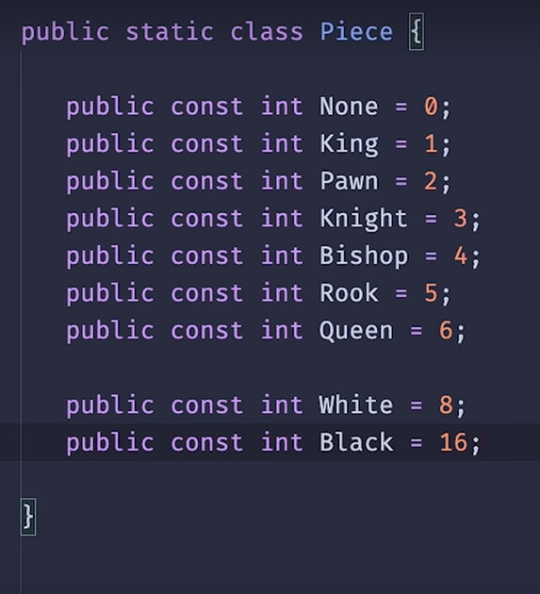

Slide 12
Why I used those numbers
if we look at a piece in binary, the 3 bits on the right will tell us what type of piece it is, and then the two bits on the left tell us if it has a colour associated with it, which can be white, or black.
6 can be represented as 100 in binary
So 1st three bits tells what type of piece it is
Next 2 bits tells weather it is black or white
16→ 10000
8 → 01000

Slide 13
Representing The Board in The Code
Now instead of setting up the board piece by piece in that array, I used the standard notation, called FEN( Forsyth–Edwards Notation).

Slide 14
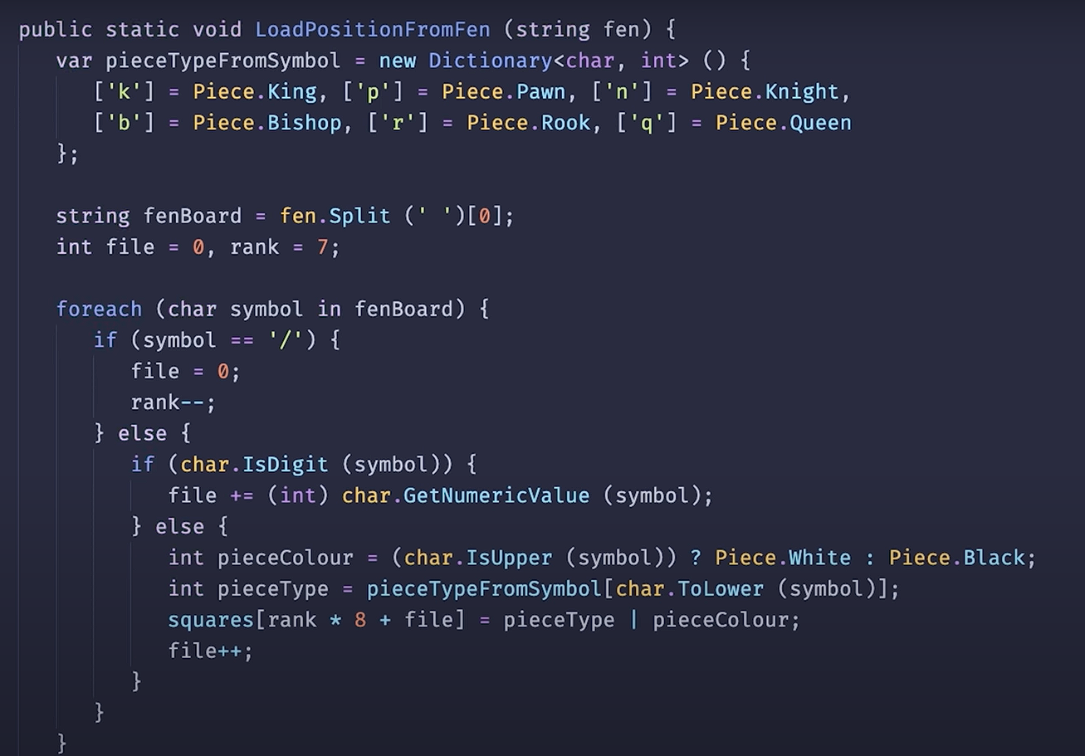
function to translate those fen strings into the format we’re using

Slide 15
Generating Moves
For generating legal moves
I have used offsets
Like if I know the position of the piece then I can add offset in it to obtain a legal move
we can move orthogonally like a rook by adding these offsets, and diagonally like bishop with these offsets.

Slide 16
Special moves
Castling
En passant
Pawn promotion

Slide 17
Castling

Slide 18
En passant

Slide 19
Pawn promotion

Slide 20
Search And Evaluation
To decide how good a position is. To do this we can decide how much each type of piece is worth
so knights and bishops are probably worth about 3 pawns, a rook is with a little more, and a queen is somewhere in the vicinity of two rooks
. We can then add up the value of each side’s pieces like so, and what we’ll then do is subtract the one from the other,
Then we end up with a value that is zero if the position is equal
positive if the side who’s turn it is to move is doing better
and negative if the other side is doing better.

Slide 21
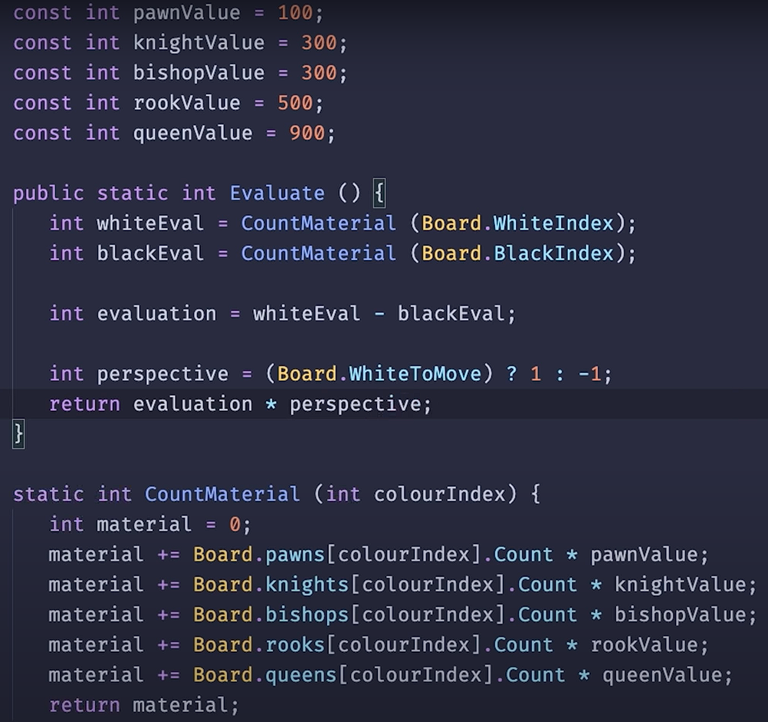
code

Slide 22
Developing AI
I used minmax Algorithm
The minimax algorithm seeks to find an optimal move, assuming the opponent will also use the minimax algorithm to find a move.
. The minimax algorithm cannot search the entire game tree, so it is limited to a certain depth. Once the depth reaches its limit, the program evaluates the board state, by assigning a value to each type of piece

Slide 23
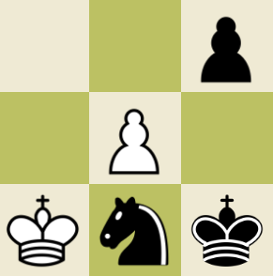
How it works
Consider this 3x3 chess board with white to move. Assume if a pawn moves to the last rank, it will get promoted to a queen.
In this board state, there are three possible moves for white:
1.Move the king up one square
2. Move the pawn up one square
3. Capture the black pawn on the top right
My thought process for this is to think about each move, and what the opponent would do in return.

Slide 24
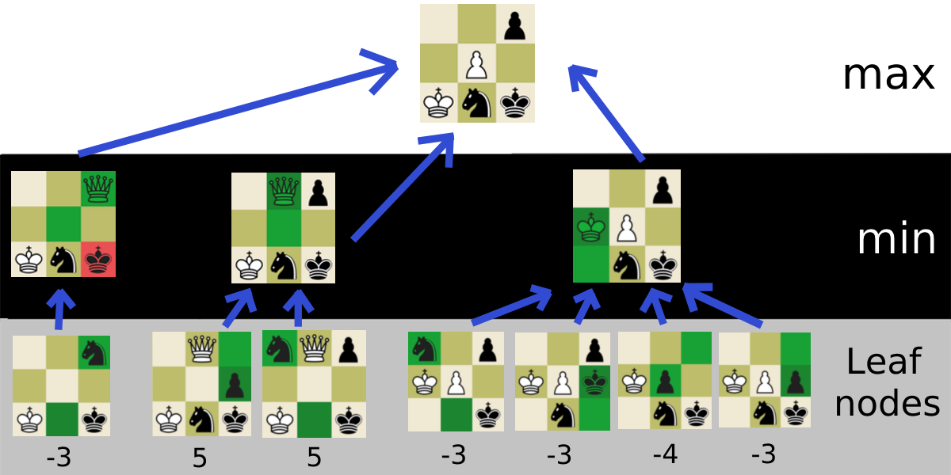

Slide 25
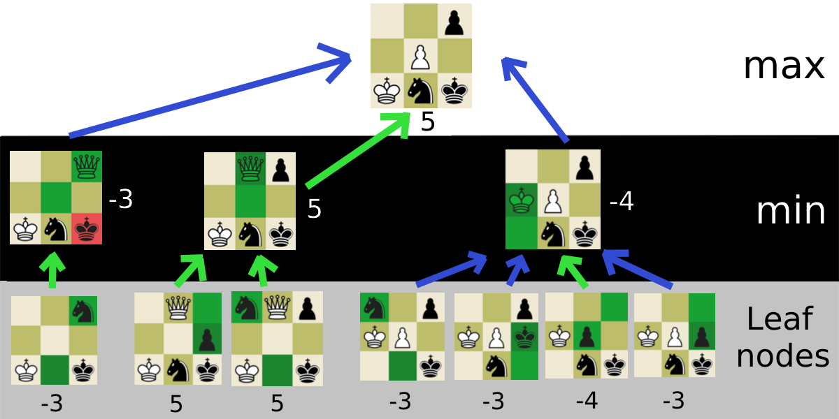

Slide 26
What it can do
This algorithm can show some ressemblence to what humans think when they play chess. It can do following Actions
Move pieces into reasonable positions
Capture a piece that is out in the open
Move a piece that is being attacked out of the way
Spot a winning move
Trade weaker pieces for stronger ones

Slide 27

THANK YOU

